Slide 1
IBM University Engagement Project Submission
“Exploring the Power of Agentic AI with IBM Granite and IBM Bob”

Slide 2

Project Tile – FITNESS BUDDY
Domain of Project – HEALTHCARE
Student Name | Recent Passport Photo | Email ID | Mobile number [WhatsApp]
POTTURI HEMA SPHOORTHI |  | AICTE:hemasphoorthi15@gmail.com IBM:hemasphoorthi07@gmail.com | 8248816412

Slide 3
Problem Statement -
Problem Statement No. 13 – Fitness Buddy
The Challenge
In today’s fast-paced world, many individuals struggle to maintain a healthy lifestyle due to lack of personalized guidance, time constraints, and inconsistent motivation. Traditional fitness solutions may require expensive subscriptions, in-person consultations, or fixed schedules that do not adapt to individual needs.
There is a growing need for an accessible and intelligent virtual fitness assistant that provides on-demand fitness advice, healthy lifestyle suggestions, and basic nutrition guidance tailored to users.
The Objective
Build an AI-powered Fitness Agent, called Fitness Buddy, that provides personalized fitness and lifestyle guidance. The solution should:
• Personalized Workout Plans – Recommend home workouts based on fitness goals, preferences, and available time.
• Motivation & Inspiration – Provide daily fitness tips and encouragement to help users stay consistent.
• Nutrition Guidance – Suggest simple and nutritious meal ideas based on fitness goals.
• Habit Building – Encourage healthy routines and consistency through personalized feedback.
• Multi-Agent System –
• Workout Recommendation Agent – Provides personalized workout routines.
• Motivation Agent – Provides encouragement and fitness inspiration.
• Nutrition Guidance Agent – Suggests healthy meal ideas.
• Habit & Progress Agent – Supports habit-building and provides progress feedback.
Technology
The solution uses IBM Cloud Lite services, IBM watsonx.ai, and IBM Granite Models. IBM Bob is used to build and develop the Fitness Buddy agent, providing an intelligent and interactive fitness assistant.

Slide 4
Proposed Solution -AI-Powered Fitness Agent
Proposed Solution: AI-Powered Fitness Agent
The proposed solution is an AI-powered Fitness Agent, called Fitness Buddy, built using IBM Bob, IBM watsonx.ai, and Granite Models to provide personalized, accessible, and on-demand fitness and lifestyle guidance. The system addresses common challenges such as lack of personalized guidance, time constraints, inconsistent motivation, and difficulty maintaining healthy habits.
At its core, the solution uses an AI-powered conversational approach to understand user inputs and provide relevant fitness recommendations. The agent can analyze information such as the user's fitness goals, preferences, available time, and daily routine to generate practical and personalized suggestions.
The system consists of four key capabilities:
Workout Recommendation Agent recommends home workouts and exercise routines based on the user's fitness goals, experience level, available time, and preferences.
Motivation & Habit Agent provides daily fitness inspiration, motivational tips, and reminders to help users stay consistent and build sustainable healthy habits.
Nutrition Guidance Agent suggests simple and nutritious meal ideas based on the user's fitness goals and lifestyle, supporting a balanced approach to health and fitness.
Fitness Tracking & Feedback Agent allows users to share their progress, receive feedback, and get actionable recommendations to improve their workout consistency and overall fitness journey.
The solution includes a user-friendly conversational interface where users can interact with Fitness Buddy and receive personalized fitness and lifestyle recommendations in real time. The system can also track user goals and progress, helping users stay motivated and maintain consistency over time.
IBM Bob is used to build and orchestrate the AI agent workflows, while IBM watsonx.ai and Granite Models provide the intelligence required for understanding user inputs, generating personalized recommendations, and delivering conversational guidance. The solution can be developed using IBM Cloud Lite services to support the required cloud-based AI capabilities.
Overall, Fitness Buddy delivers an accessible and intelligent virtual fitness companion that helps users make healthier choices, follow personalized workouts, improve consistency, and work toward their fitness goals anytime and anywhere.

Slide 5
Technology Used
IBM Bob Platform – For designing and orchestrating the Fitness Buddy’s multi-agent workflows visually, enabling different agents to work together for personalized fitness and wellness assistance.
IBM Granite Model – For example, IBM Granite 4-H small – For natural language understanding, reasoning, and personalization, helping Fitness Buddy understand user queries and provide relevant fitness recommendations.
IBM Cloud – It provides the infrastructure to build, deploy, and scale the Fitness Buddy application efficiently. IBM Cloud enables a reliable, secure, and scalable environment for running the Fitness Buddy agents and services.
RAG (Retrieval-Augmented Generation) – Used to retrieve relevant and reliable fitness and nutrition information from available data sources before generating responses, making Fitness Buddy’s recommendations more informative, accurate, and trustworthy.
Multi-Agent System – Enables different specialized agents to handle tasks such as workout planning, nutrition guidance, fitness recommendations, and user personalization, working together to provide a complete fitness experience.

Slide 6
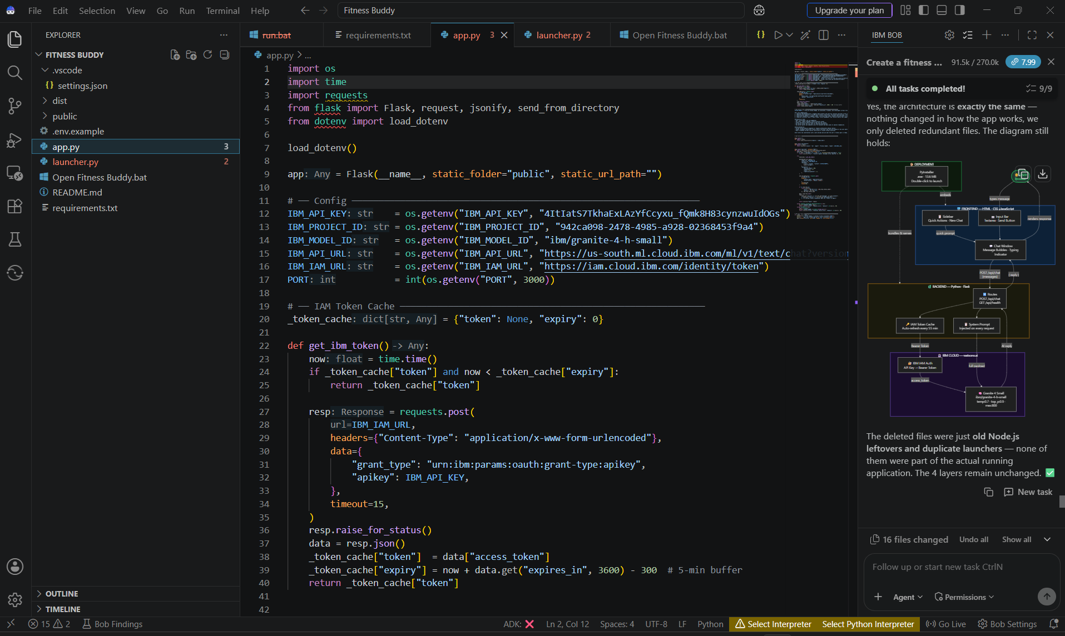
Required Files created using IBM bob -

Slide 7
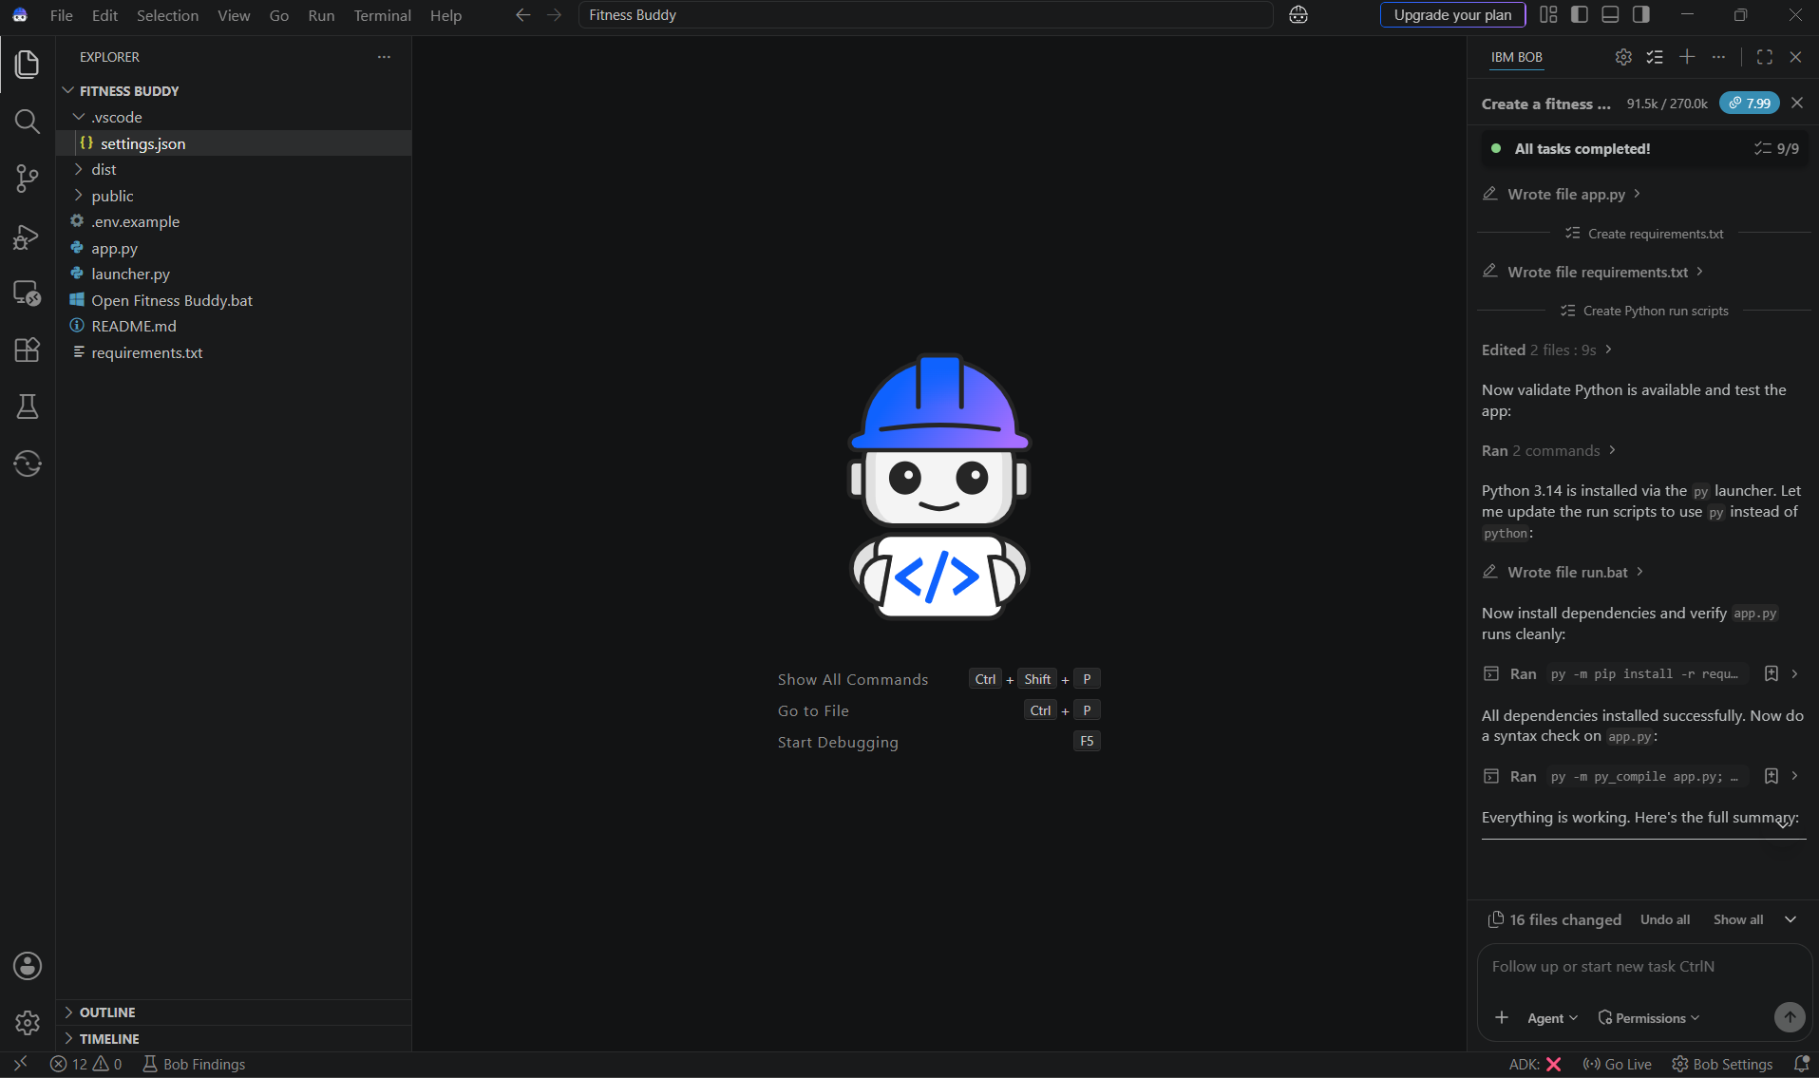
IBM Bob Screenshots:

Slide 8
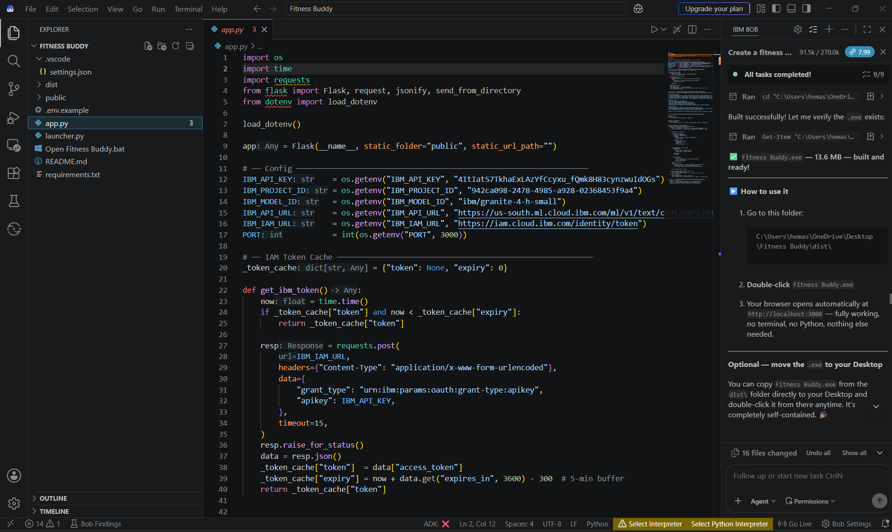

Slide 9
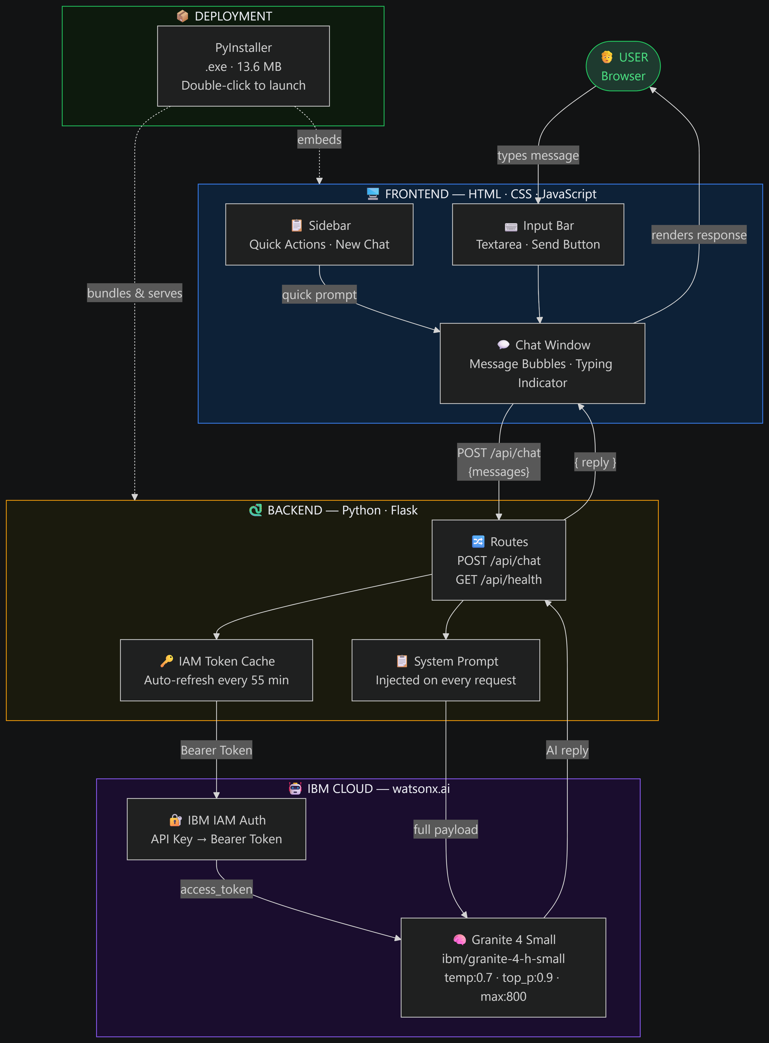
Architecture blueprint for IBM bob:

Slide 10

Role of Agentic AI in the solution
Role of Agentic AI in Fitness Agent
Agentic AI enables the Fitness Buddy to function as an intelligent, goal-oriented system rather than a simple chatbot. Using IBM watsonx.ai and IBM Granite models, it provides personalized fitness guidance and intelligently handles different fitness-related tasks.
The system consists of specialized capabilities—such as recommending workouts, providing motivation, suggesting healthy meals, and tracking fitness progress—that work together to address different user needs. This multi-agent approach helps the system provide relevant and personalized responses efficiently.
Agentic AI also brings context awareness, understanding user details such as fitness goals, preferences, available time, and daily routine to generate suitable recommendations. It supports real-time adaptation, updating workout and lifestyle suggestions based on user feedback and changing requirements.
Additionally, the system can combine information from different fitness activities to support better decision-making—for example, recommending appropriate workouts based on fitness goals and suggesting nutrition choices that complement the user's routine.
Overall, Agentic AI makes Fitness Buddy personalized, adaptive, proactive, and goal-driven, acting as a smart digital fitness coach that helps users stay motivated, build healthy habits, and achieve their fitness goals.

Slide 11
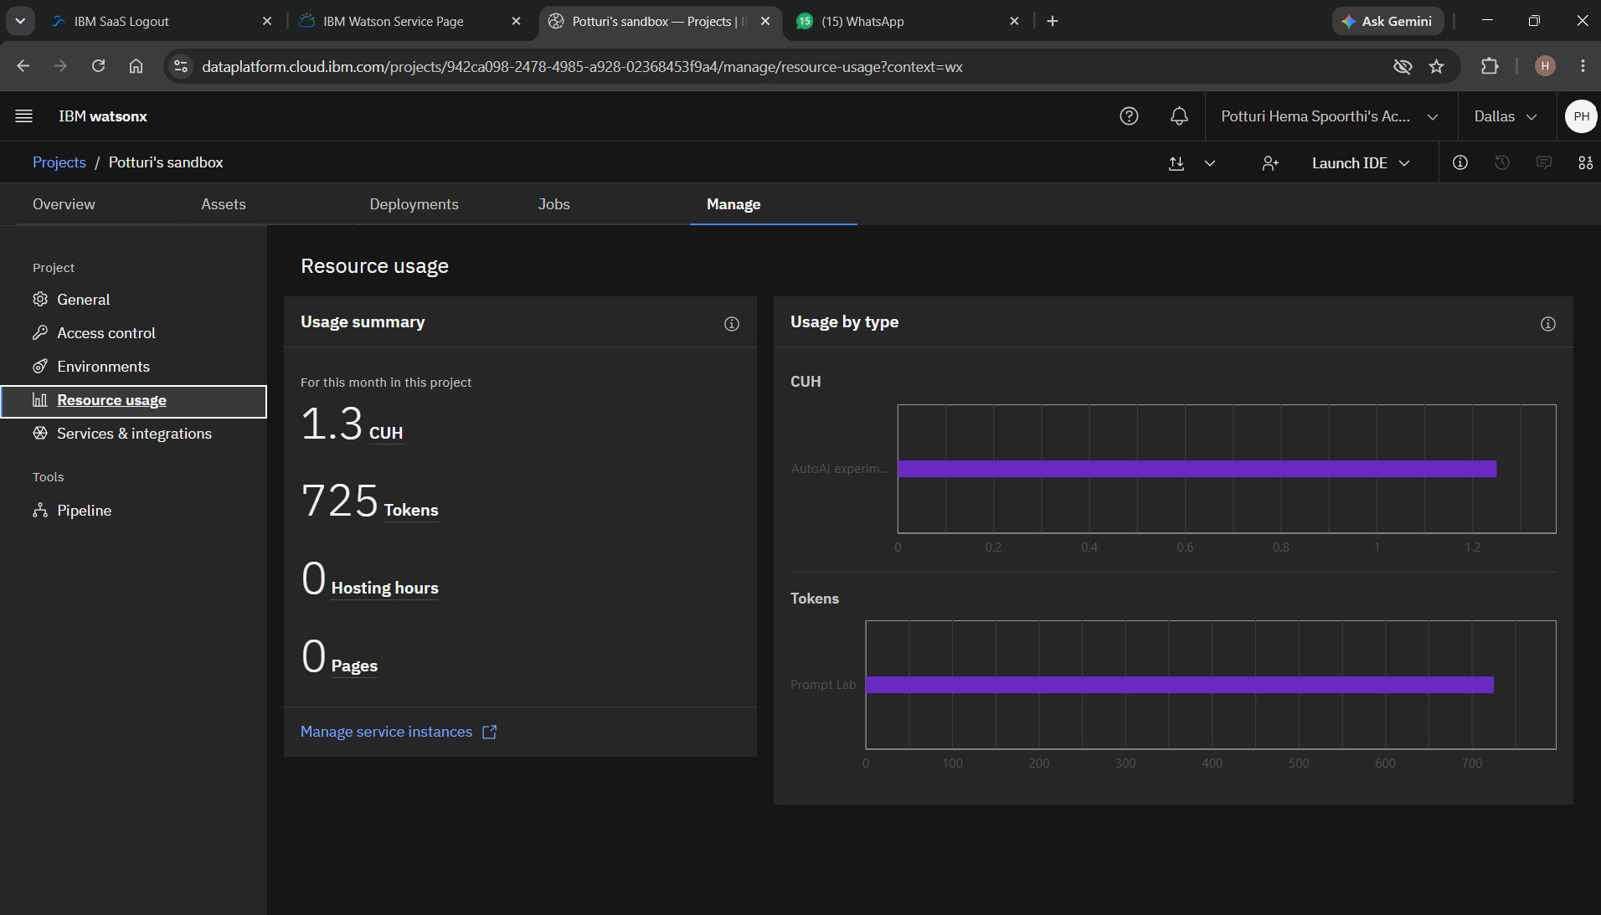
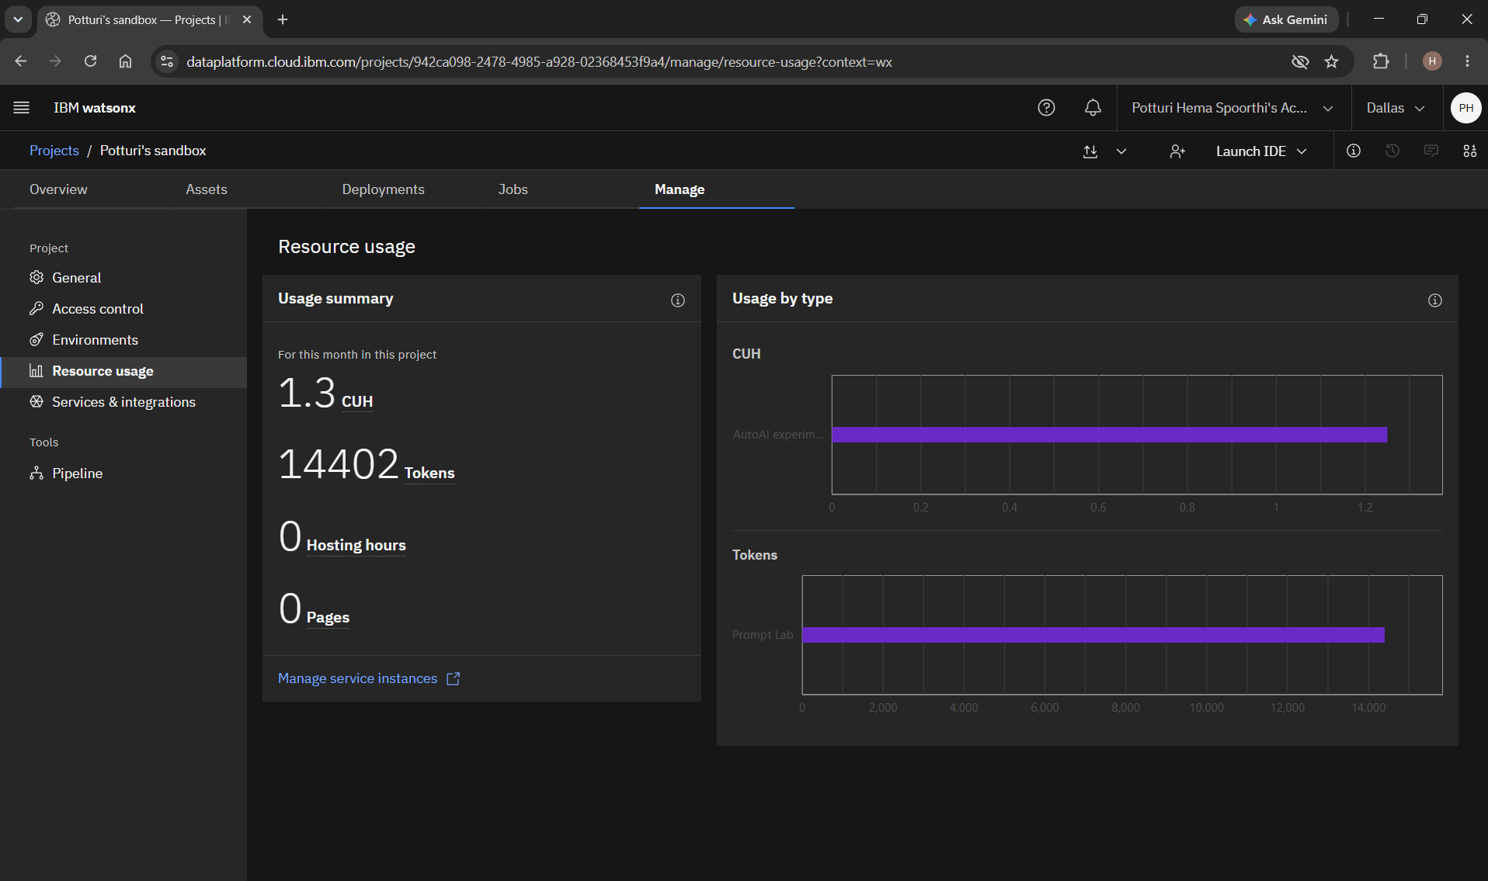
Token Usage
13,677 token are used
Before Prompt
After the Prompt
·
·
·

Slide 12
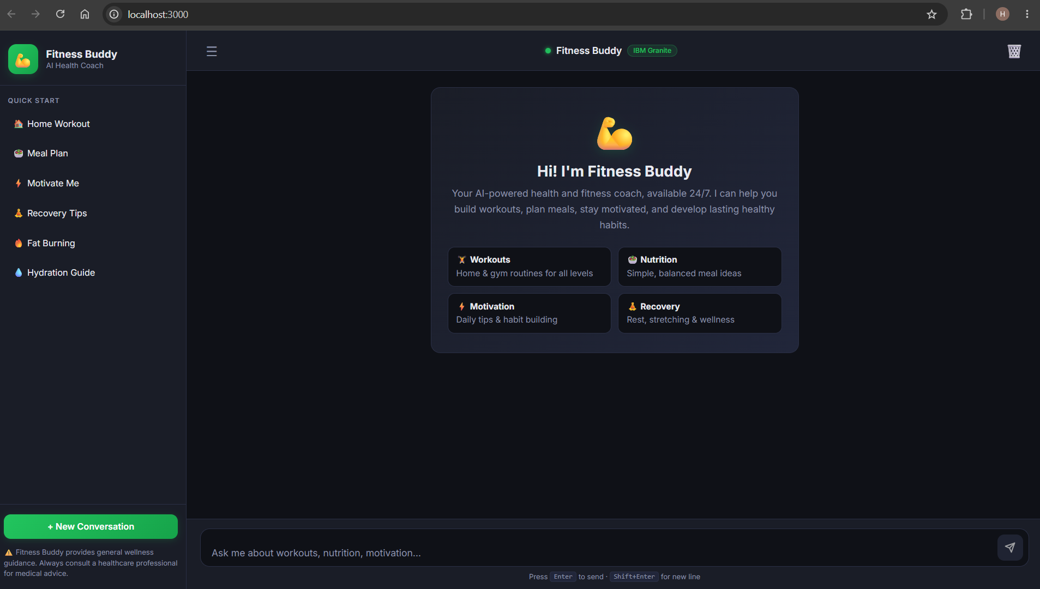
Project Output Screenshot
Please put IBM Bob output screenshots with 2-3 prompts.
You can take 2-3 more slides for each screenshot
·
·
·

Slide 13
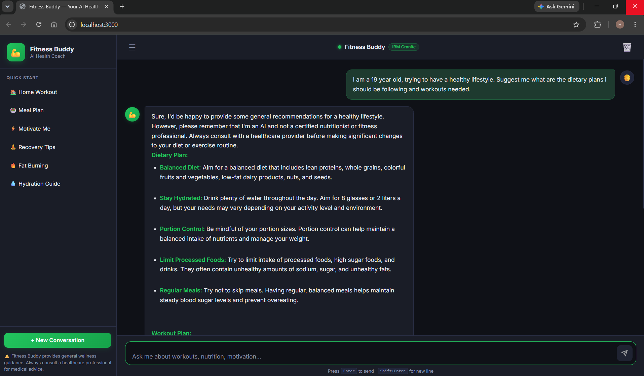
Project Output Screenshot
Please put IBM Bob output screenshots with 2-3 prompts.
You can take 2-3 more slides for each screenshot
·
·
·

Slide 14
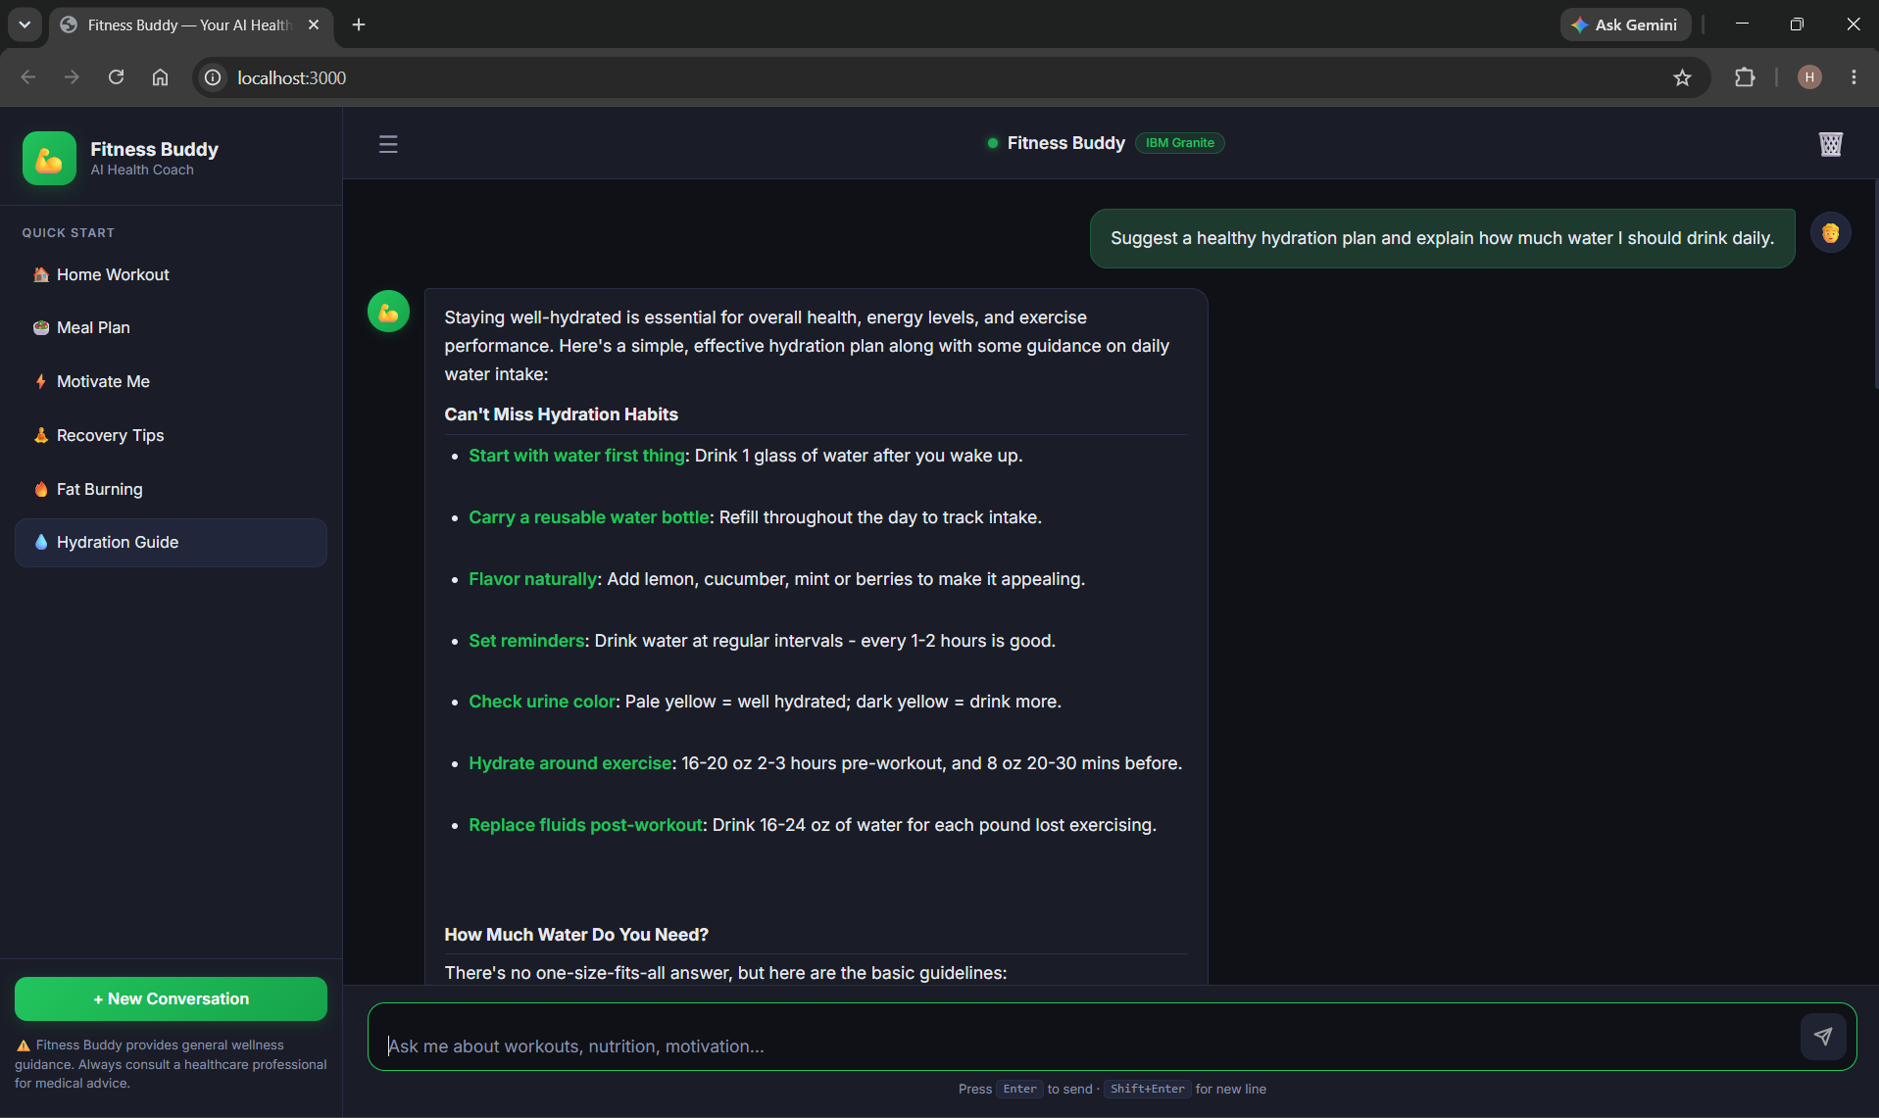
Project Output Screenshot
Please put IBM Bob output screenshots with 2-3 prompts.
You can take 2-3 more slides for each screenshot
·
·
·

Slide 15
Novelty and Uniqueness
The proposed Fitness Buddy stands out by combining Agentic AI, personalization, and real-time fitness guidance into a single intelligent system.
Multi-Agent Intelligence – Instead of a single chatbot, multiple specialized agents work together to provide personalized workout, motivation, nutrition, and habit-building support.
Personalized Guidance – Tailors workout routines and lifestyle suggestions based on the user's fitness goals, preferences, available time, and daily routine.
Real-Time Feedback Loop – Adapts recommendations based on user inputs, progress, and feedback to provide more relevant guidance.
Motivation & Habit Building – Provides daily motivation and encourages users to build healthy habits and maintain consistency.
Nutrition Support – Suggests simple and nutritious meal ideas that complement the user's fitness goals.
Conversational Interaction – Allows users to interact naturally with Fitness Buddy and receive fitness guidance whenever needed.
Scalable & Accessible – Built using IBM watsonx.ai, IBM Granite models, and IBM Cloud Lite services, with IBM Bob used to develop the intelligent fitness agent.
This makes Fitness Buddy a smart, adaptive, and proactive digital fitness coach, rather than just a basic workout recommendation tool.

Slide 16
Git Hub Link
https://github.com/Hema-Sph/Fitness-Buddy
·
·
·

Slide 17
Future Scope
Future Scope
1. Integration with Wearables & Fitness Devices –
The system can be integrated with smartwatches and fitness trackers to collect real-time data such as steps, calories burned, heart rate, and sleep patterns. This will enable Fitness Buddy to provide more accurate and personalized workout and lifestyle recommendations based on actual user activity.
2. AI-Powered Voice Assistant & Multilingual Support –
Enhancing the system with a voice-enabled assistant and multilingual support will improve accessibility and usability. Users can interact naturally in their preferred language, making Fitness Buddy more inclusive and suitable for users from diverse backgrounds.
·
·
·

Slide 18
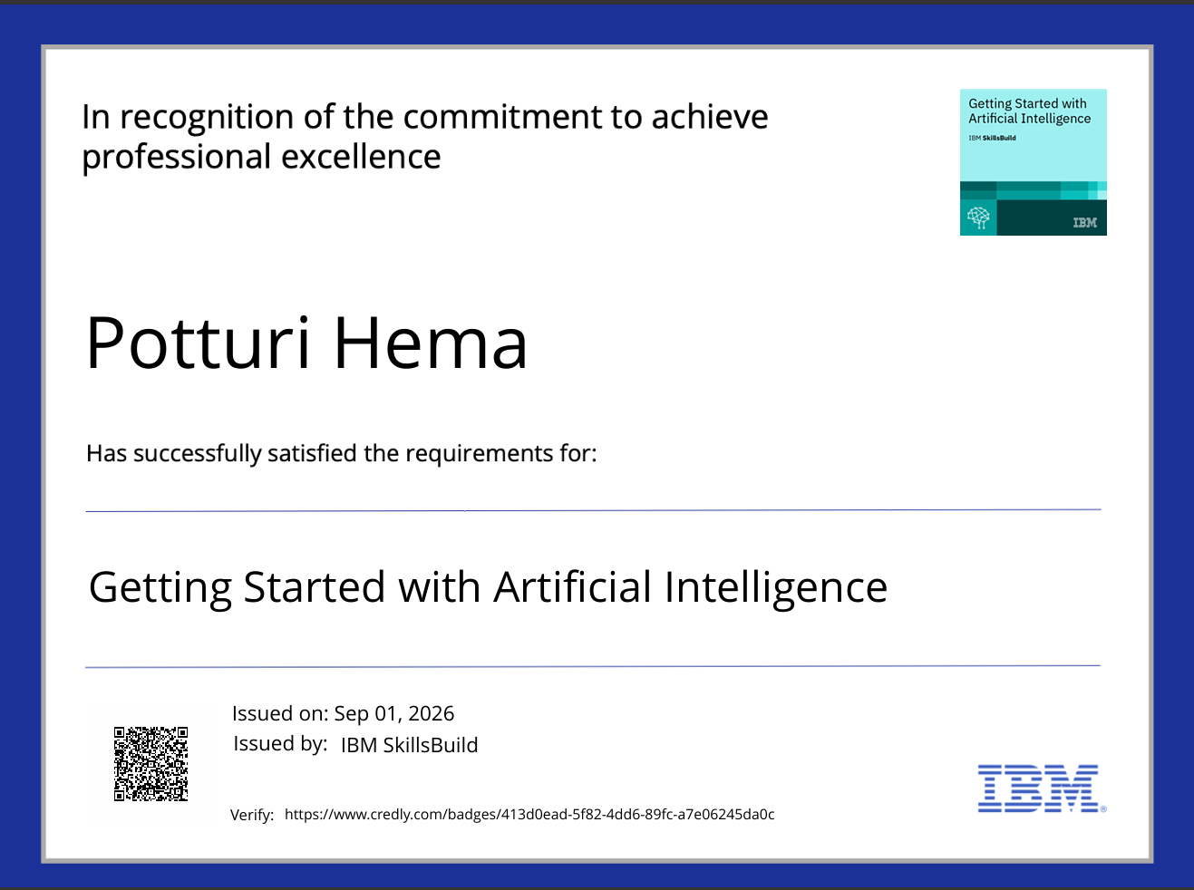
Certificates Earned:
Credly certificate(Getting Started with Artificial Intelligence)

Slide 19
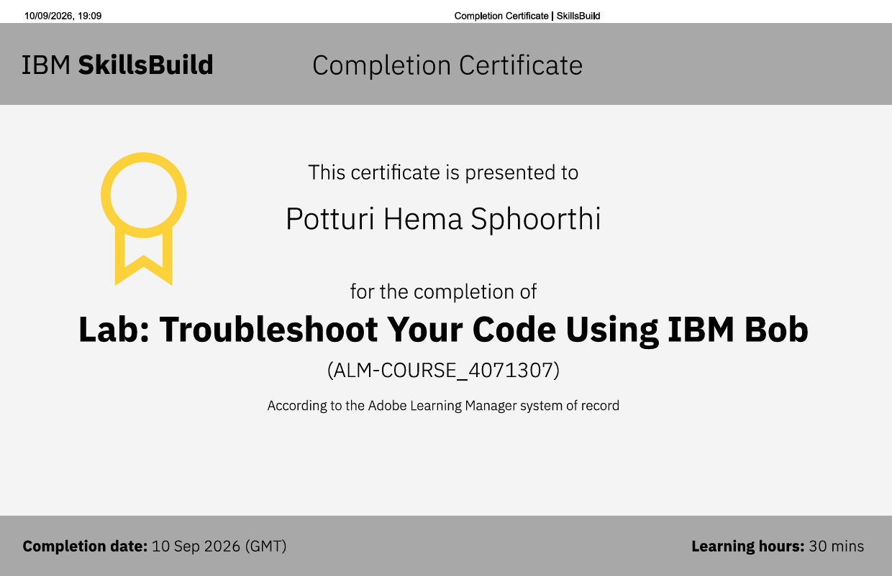
Certificates Earned:​
IBM BOB Certificate

Slide 20


